Slide 1





PEOPLE’S COMMITTEE OF TAN BINH DISTRICT
CHI LANG PRIMARY SCHOOL
Grade: 2
GETTING STARTED
Teacher: Hoàng Thị Thanh Thảo

Slide 2
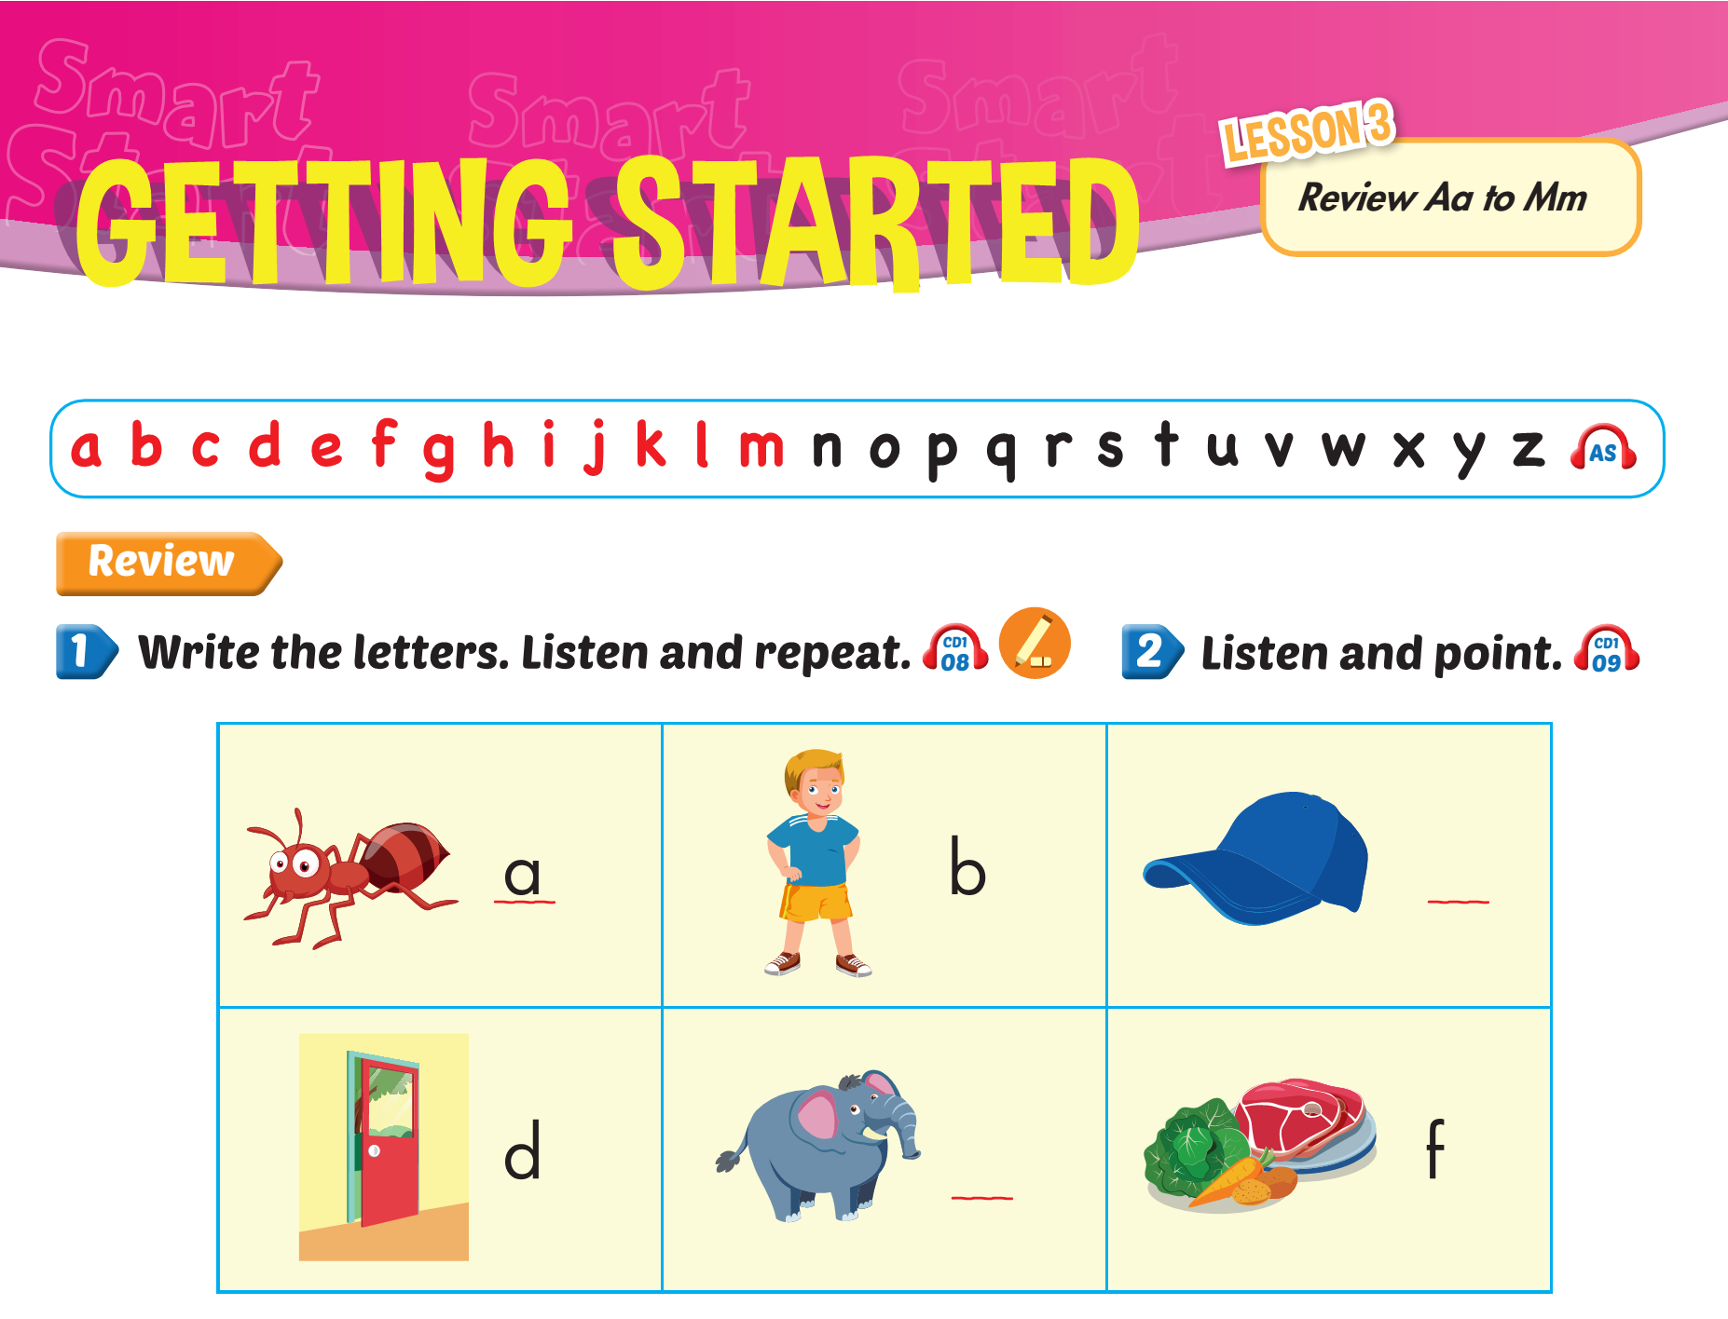
Lesson 2

Slide 3
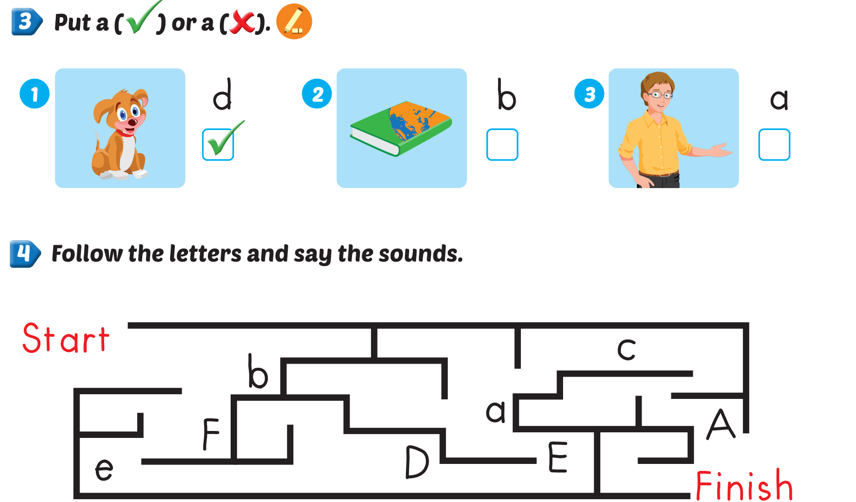


Lesson 3

Slide 4
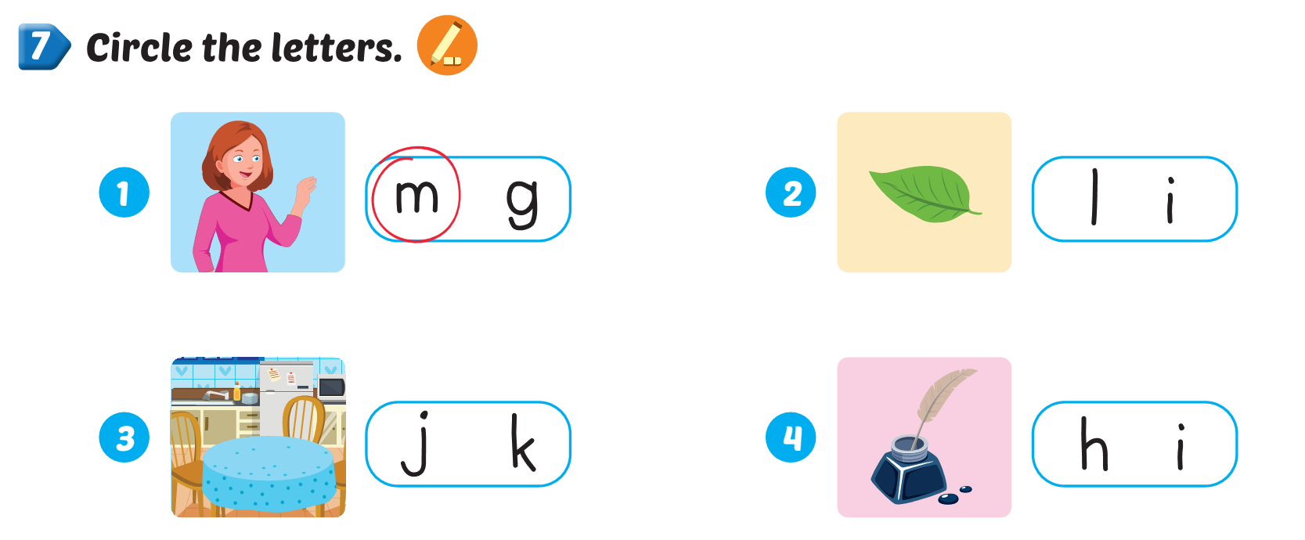
Lesson 3

Slide 5
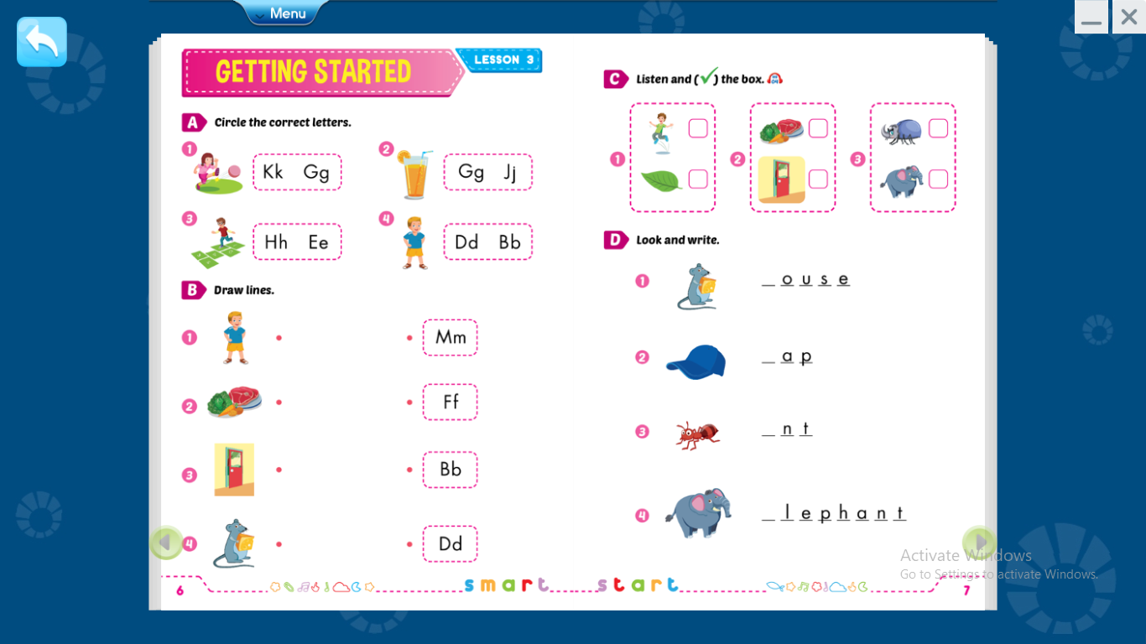

Slide 7
m
c
a
e

Slide 8







Thank you for enjoying
the lesson !

